Slide 1

Deployment to IIS

Slide 2
What is IIS
IIS or Internet Information Server is the server used to host .Net web applications. IIS is normally installed on a Window Server.
Internet Information Server (IIS) has it's own ASP.NET Process Engine to handle the ASP.NET request.
User Request for Some Information
Server Received the Request
Process the Request and send back to User
Notes:
IIS is responsible for providing a response to requests that come from users. When a request comes from client to server IIS takes that request from users and process it and send response back to users as html content in webbrowser.

Slide 3
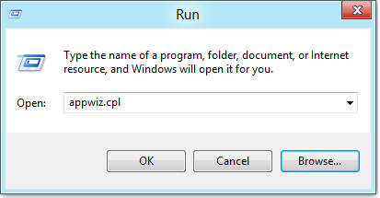
Installation of IIS in Windows
Press the Windows + R key combination to bring up a run box, then type ‘appwiz.cpl’ and press enter.

Slide 4
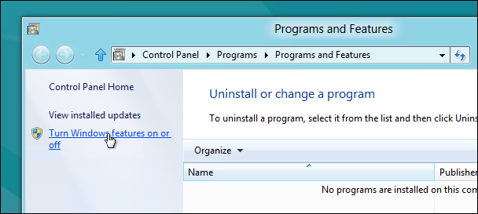
Installation of IIS in Windows
Program and Features window

Slide 5
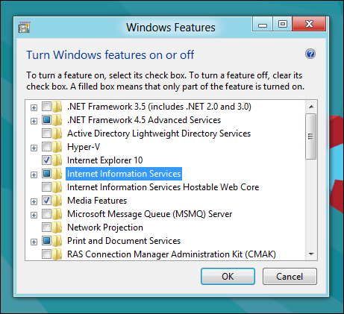
Installation of IIS in Windows
Click on Internet Information Services check box

Slide 6
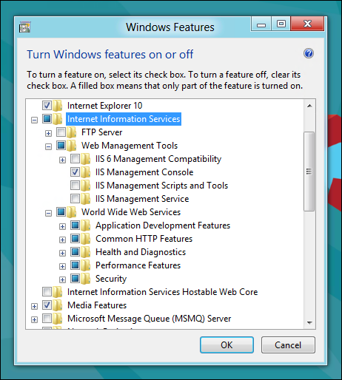
Installation of IIS in Windows
Expand the Internet Information Services node

Slide 7
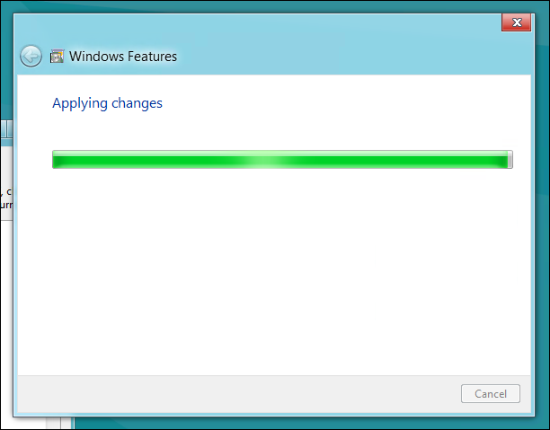
Installation of IIS in Windows

Slide 8
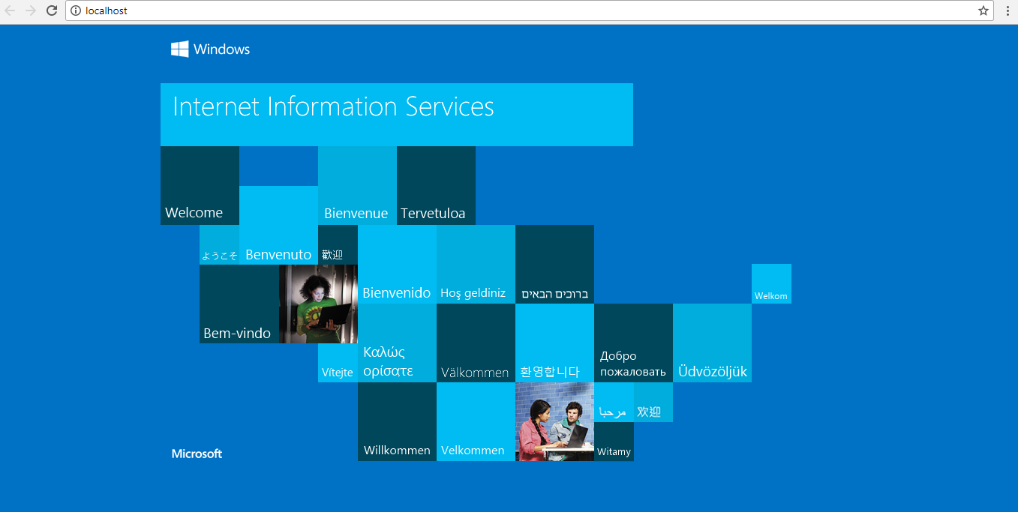
Installation of IIS in Windows
Open the browser and navigate to localhost

Slide 9
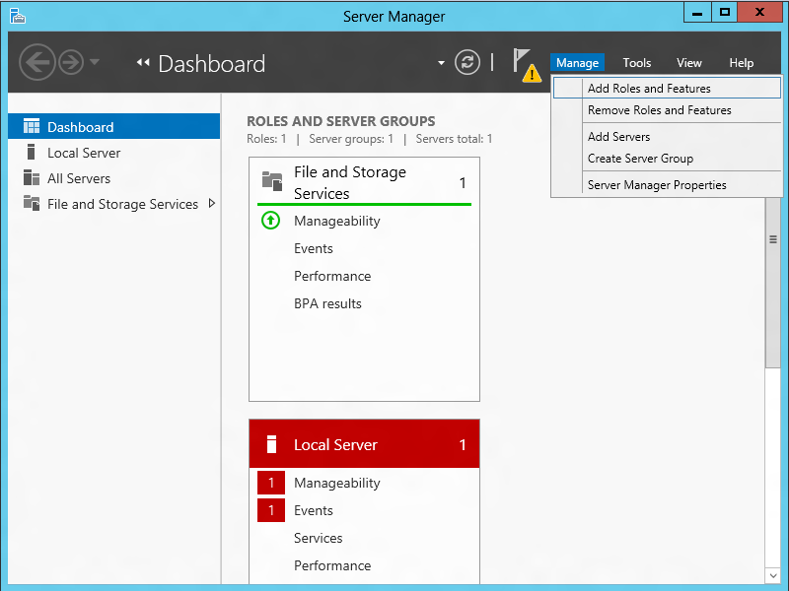
Installation of IIS in Windows Server
Open Server Manager and under Manage menu, select Add Roles and Features:

Slide 10
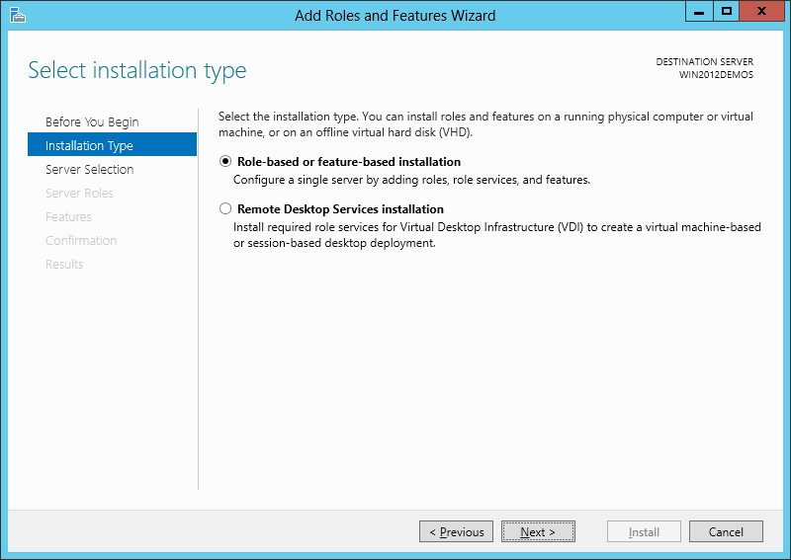
Installation of IIS in Windows Server

Slide 11
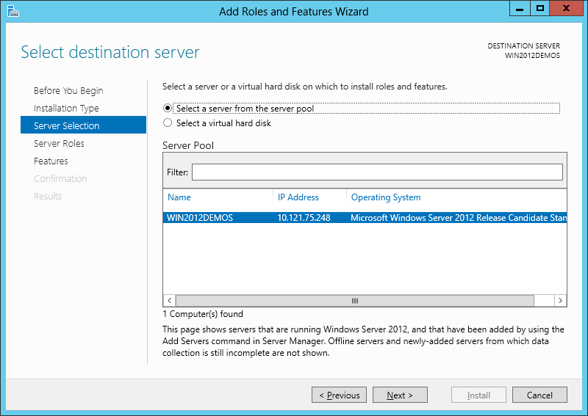
Installation of IIS in Windows Server

Slide 12
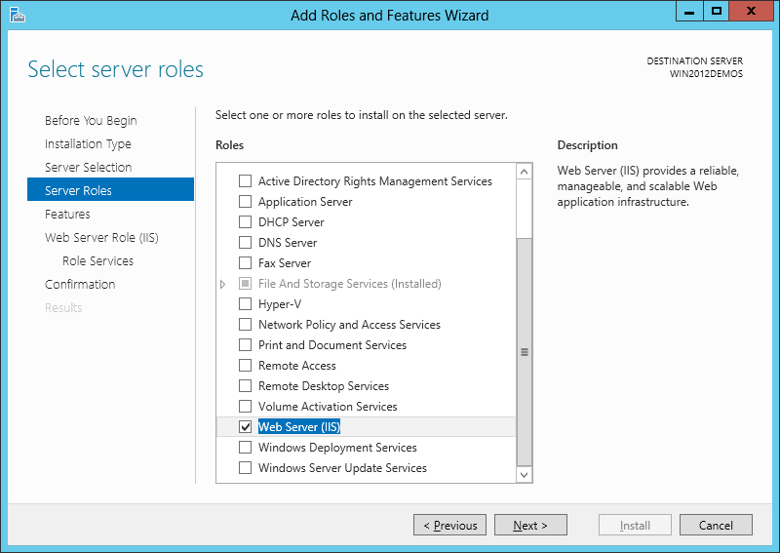
Installation of IIS in Windows Server

Slide 13
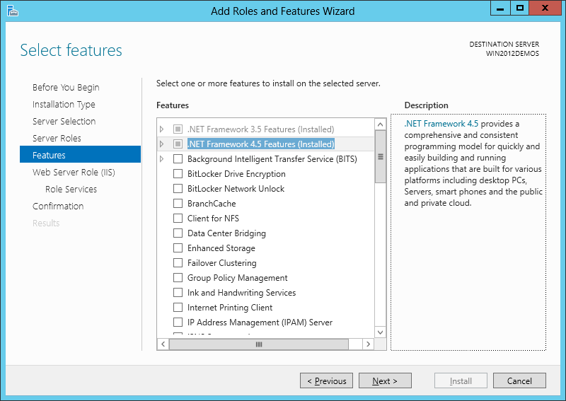
Installation of IIS in Windows Server

Slide 14
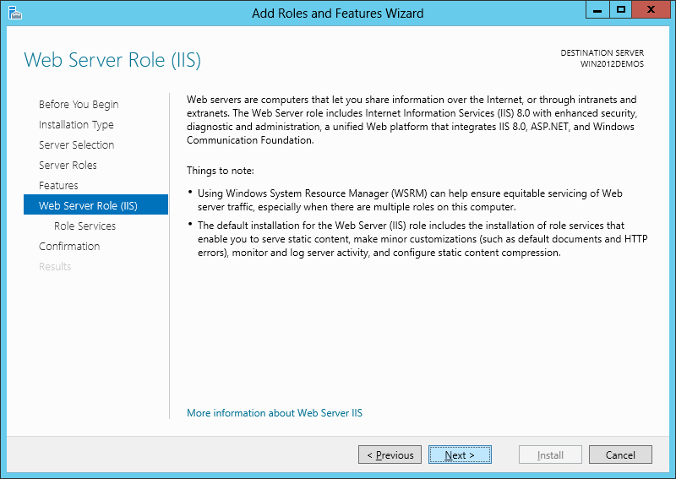
Installation of IIS in Windows Server

Slide 15
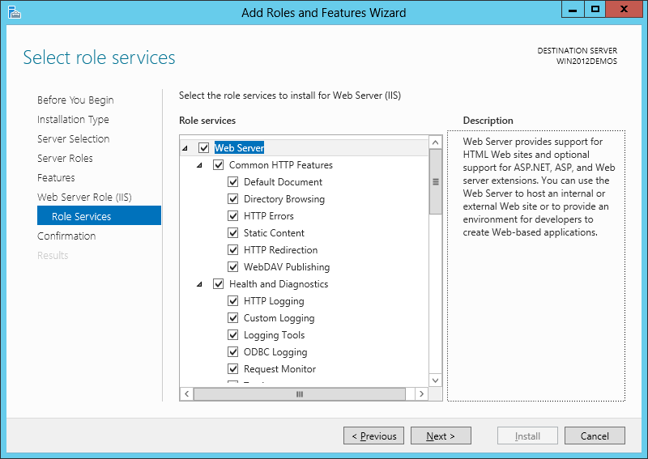
Installation of IIS in Windows Server

Slide 16
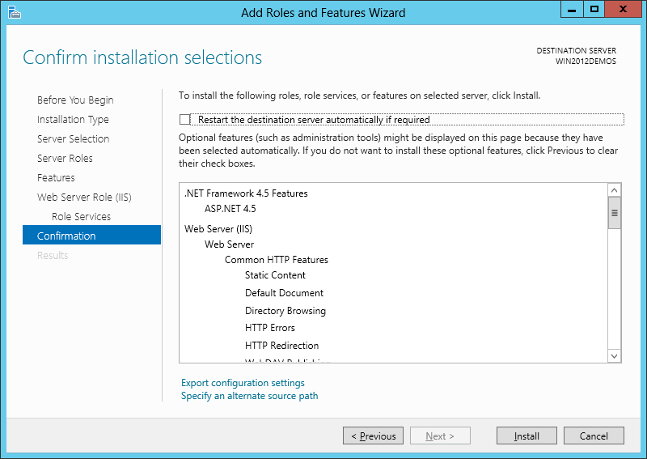
Installation of IIS in Windows Server

Slide 17
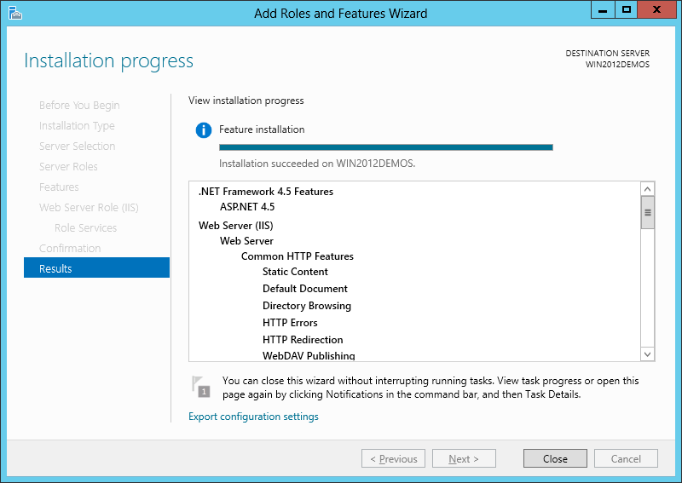
Installation of IIS in Windows Server

Slide 18
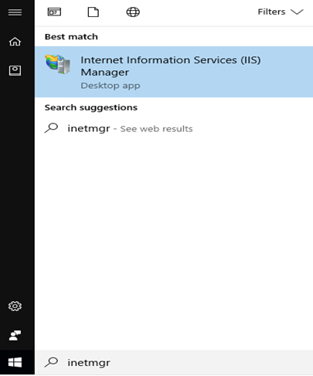
Launch IIS

Slide 19
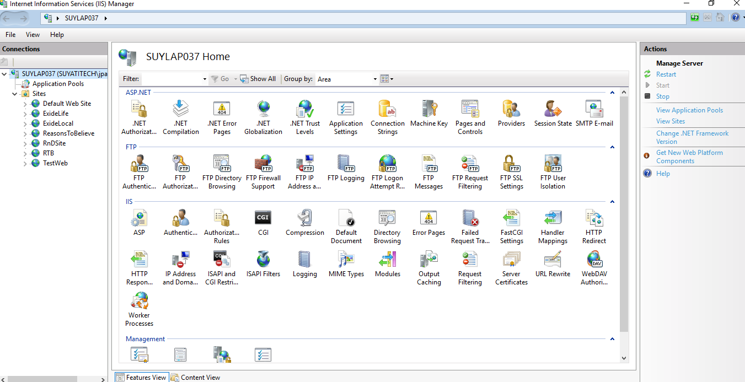
Launch IIS

Slide 20
Deployment to IIS
File Copy
Website Publish

Slide 21
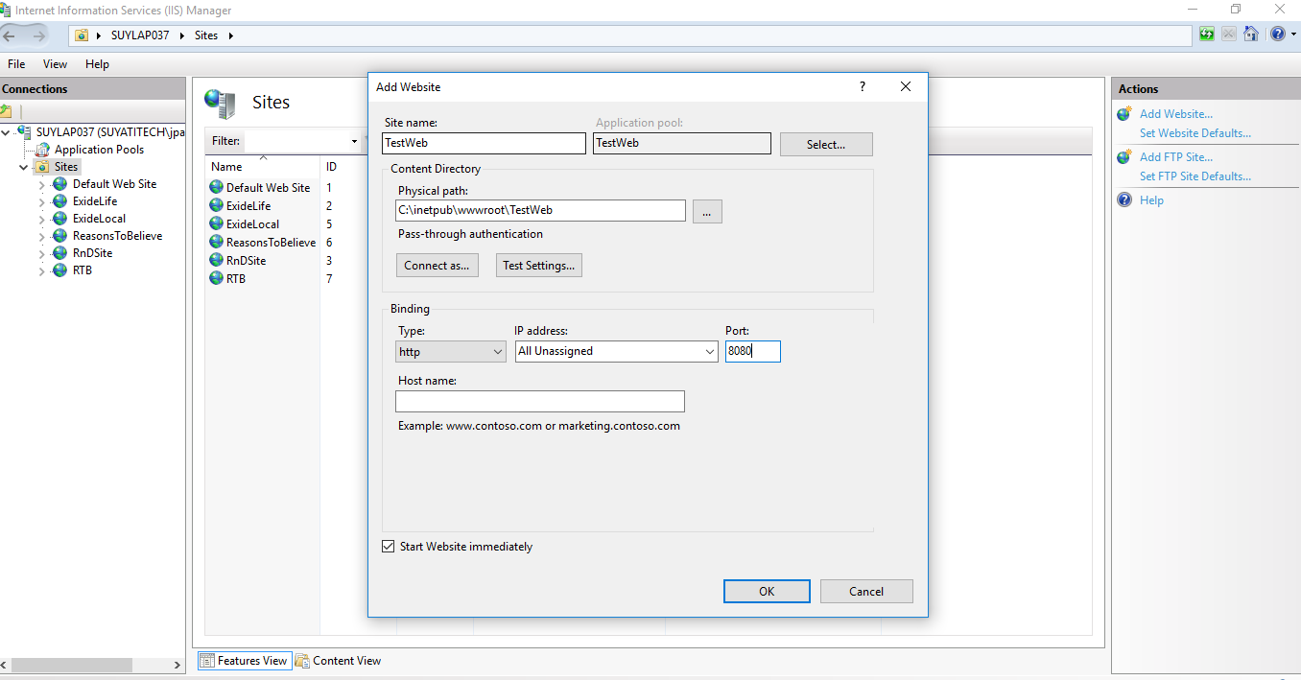
Deployment by File Copy
Create a website in IIS

Slide 22
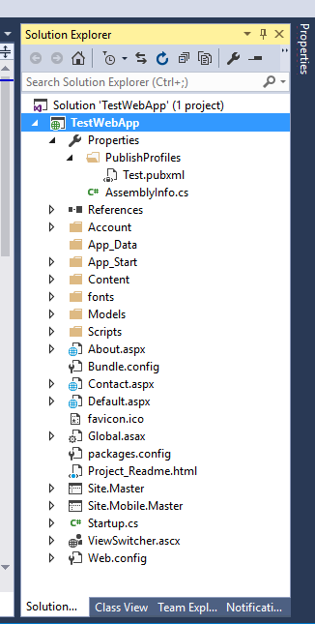
Deployment by File Copy
Create a Web Application in Visual Studio

Slide 23
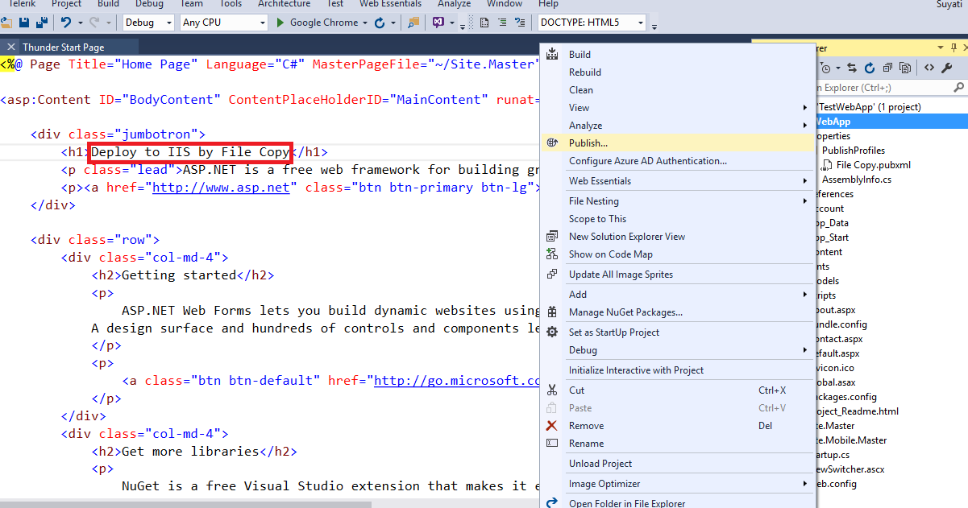
Deployment by File Copy
Update heading in default.aspx page and Publish

Slide 24
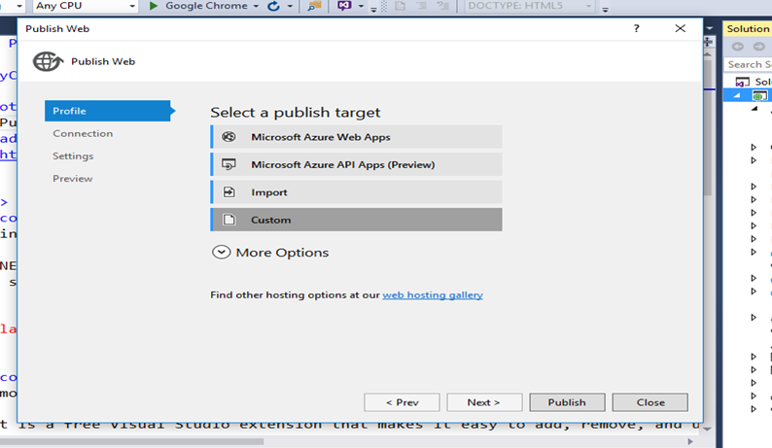
Deployment by File Copy
Create custom profile

Slide 25
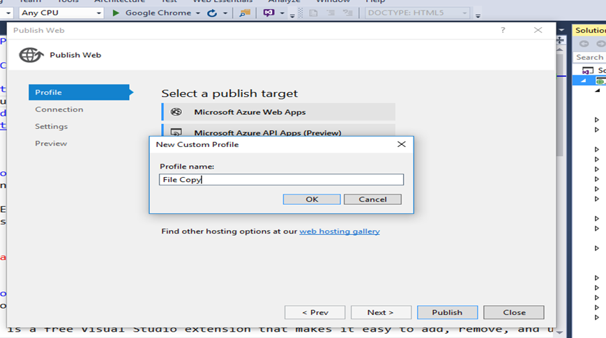
Deployment by File Copy

Slide 26
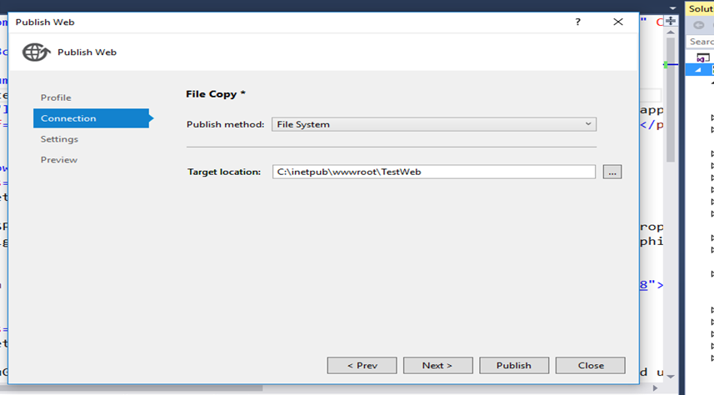
Deployment by File Copy

Slide 27
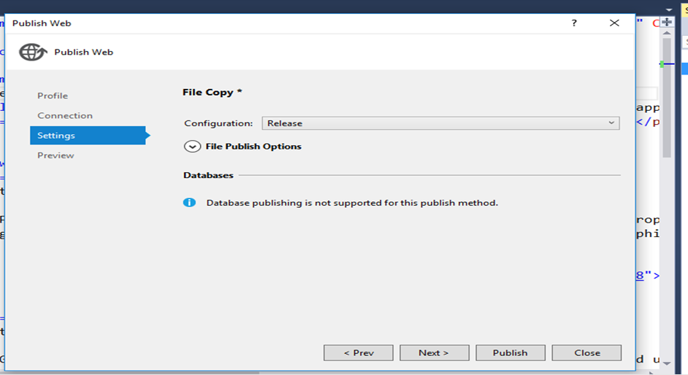
Deployment by File Copy

Slide 28
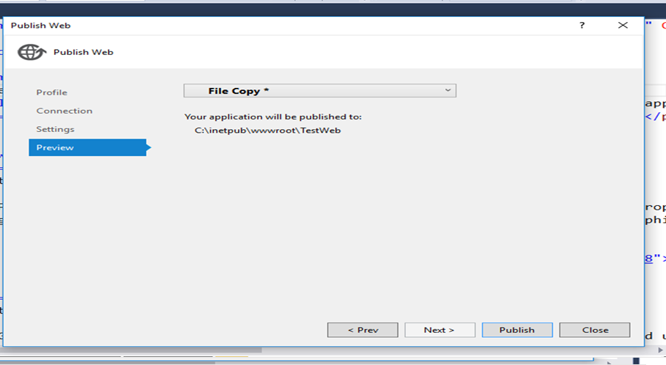
Deployment by File Copy

Slide 29
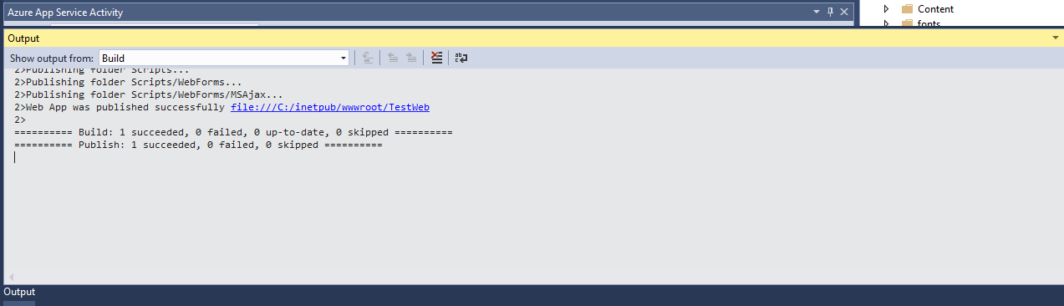
Deployment by File Copy

Slide 30
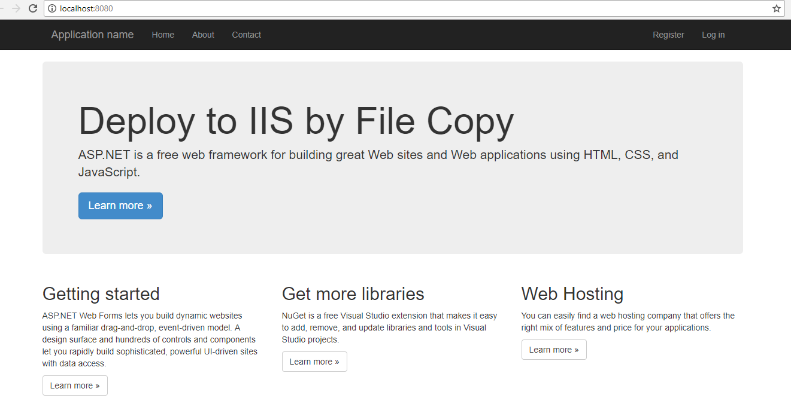
Deployment by File Copy
Open the browser and navigate to the URL – http://localhost:8080

Slide 31
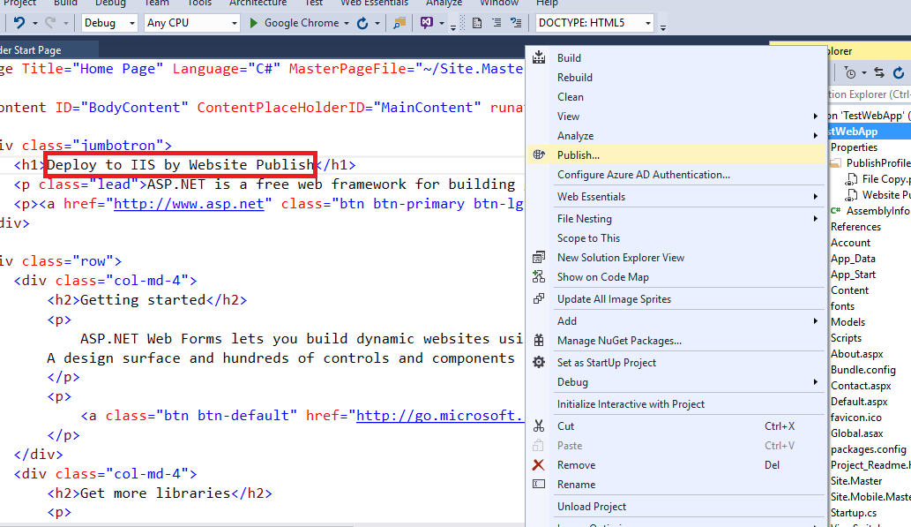
Deployment by Website Publish
Update heading in default.aspx page and Publish

Slide 32
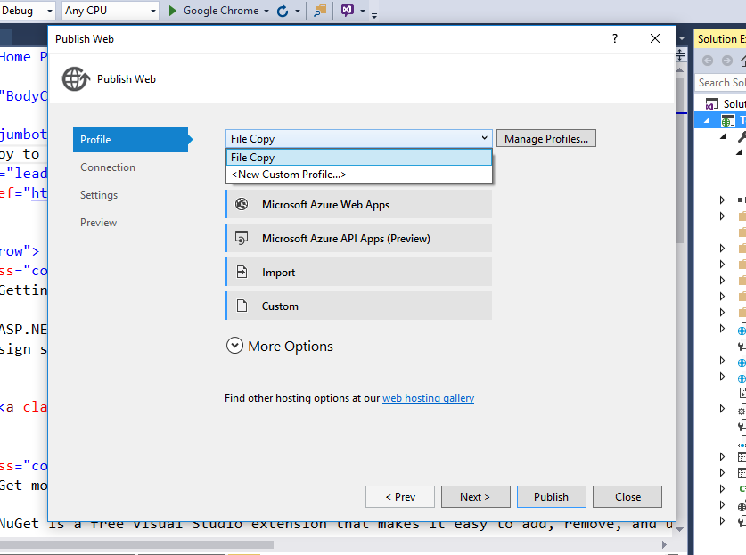
Deployment by Website Publish
Create new profile

Slide 33
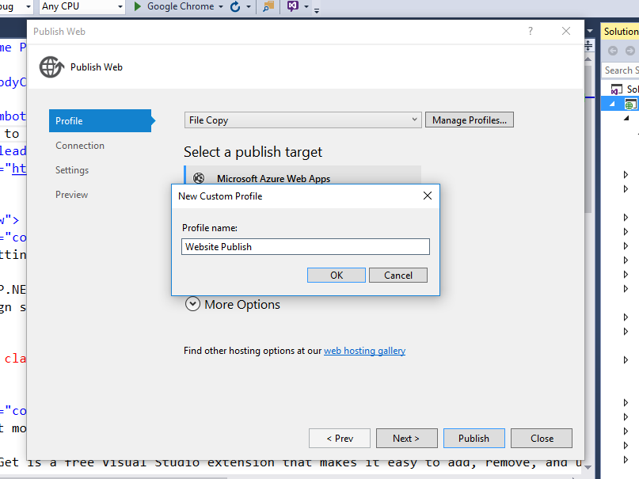
Deployment by Website Publish

Slide 34
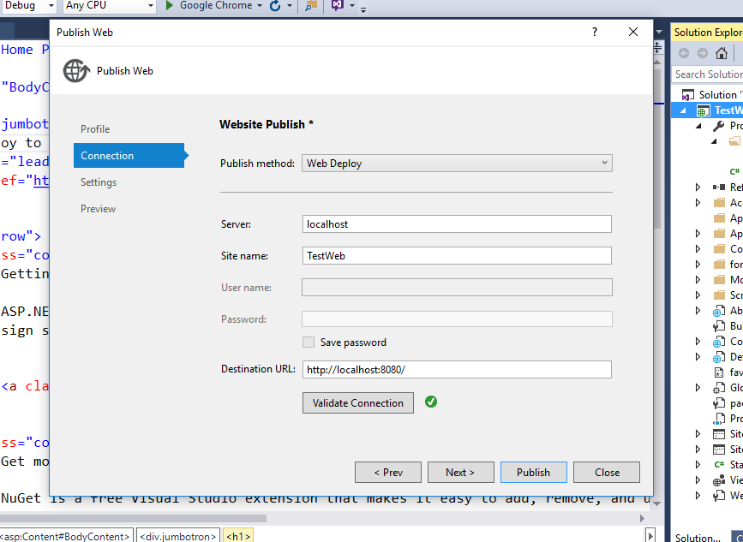
Deployment by Website Publish

Slide 35
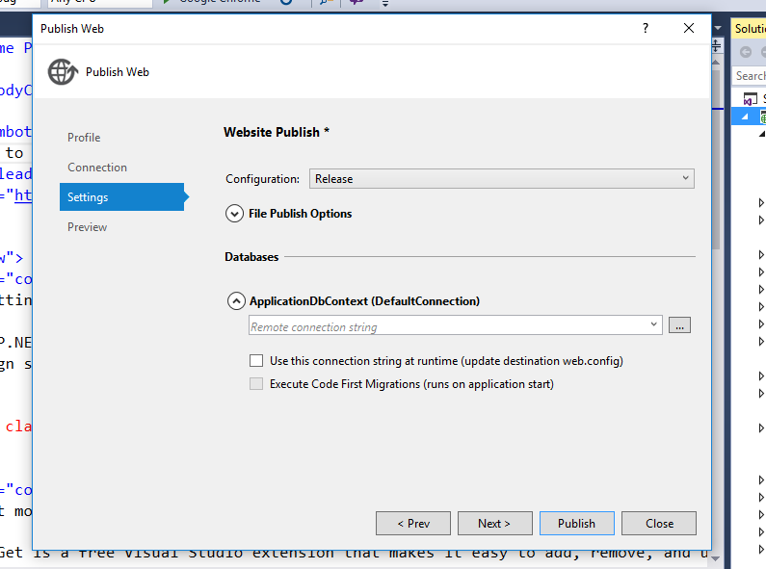
Deployment by Website Publish

Slide 36
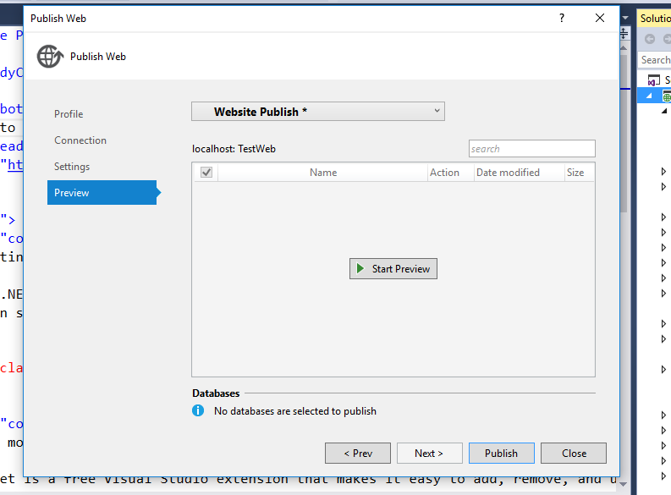
Deployment by Website Publish

Slide 37
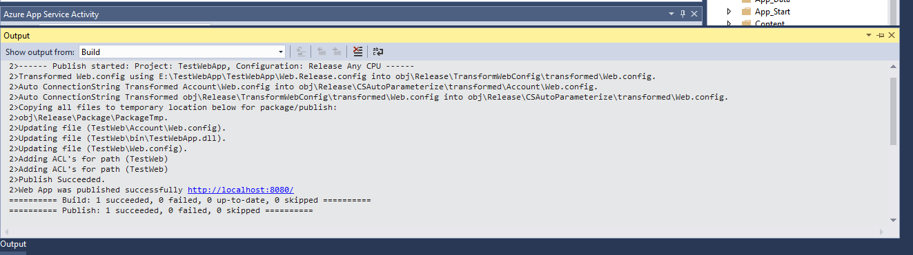
Deployment by Website Publish

Slide 38
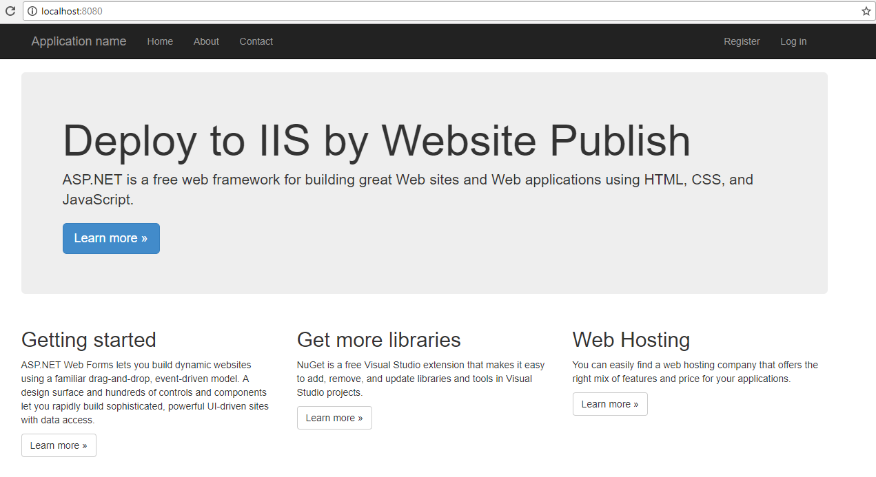
Deployment by Website Publish

Slide 39
Thank You…

